Slide 1
Build an Alexa Skill using AWS Lambda
Jeff Blankenburg
@jeffblankenburg
August 14, 2017

Slide 2
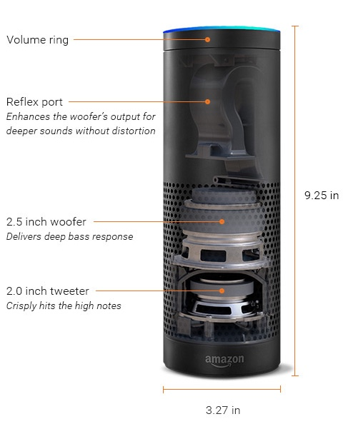
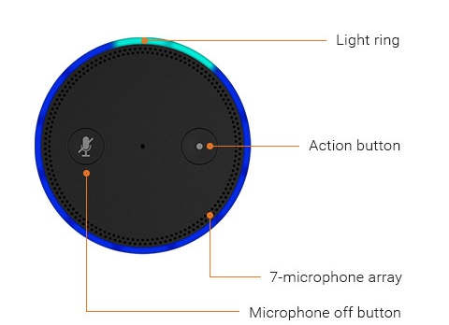
A look inside Echo

Slide 3
How Alexa Works

Slide 4


Creating an Alexa Skill
+
Voice User Interface
Programming Logic

Slide 5


Creating an Alexa Skill
+
Voice User Interface
Programming Logic
developer.amazon.com
aws.amazon.com

Slide 6


Alexa Skills Kit
Your Service
Request
Audio
Speech Recognition
Machine Learning
Natural Language Understanding
Text to speech
Response
Cards

Slide 7
Alexa Skills Kit: Signal Processing
Your Service
Request
Wake word detection Beam forming
Speech Recognition
Machine Learning
Natural Language Understanding
Text to speech
Response
Cards

Slide 8
Alexa Skills Kit: Utterances Into Intents
Your Service
Request
Utterances
Speech Recognition
Machine Learning
Natural Language Understanding
Intents
Text to speech
Response
Cards

Slide 9

ASR – Automatic Speech Recognition
foʊr maɪlz
4 Miles
For Miles
Form Isles
For My Isles

Slide 10
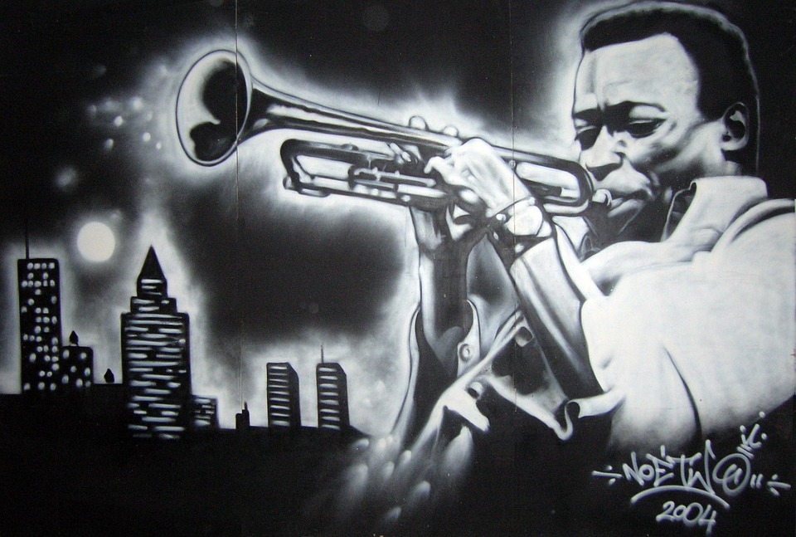
ASR – Automatic Speech Recognition
foʊr maɪlz
4 Miles
For Miles
Form Isles
For My Isles

Slide 11

ASR – Automatic Speech Recognition
foʊr maɪlz
4 Miles
For Miles
Form Isles
For My Isles

Slide 12

ASR – Automatic Speech Recognition
foʊr maɪlz
4 Miles
For Miles
Form Isles
For My Isles

Slide 13
Utterances and Intents
Alexa, ask Chicago Guide to give me an activity
wake word
launch
Invocation name
utterance

Slide 14
Utterances and Intents
Alexa, ask for an activity from Chicago Guide
wake word
launch
utterance
Invocation name
Recommend an Attraction
utterance

Slide 15
Utterances and Intents
Alexa, ask for an activity from Chicago Guide
wake word
launch
utterance
Invocation name
Recommend an Attraction
utterance
AttractionIntent
Intent

Slide 16
Built-in Slots
Give me an activity within four miles
utterance
slot value
AttractionIntent
{distance: “4”}
Intent
slot value

Slide 17
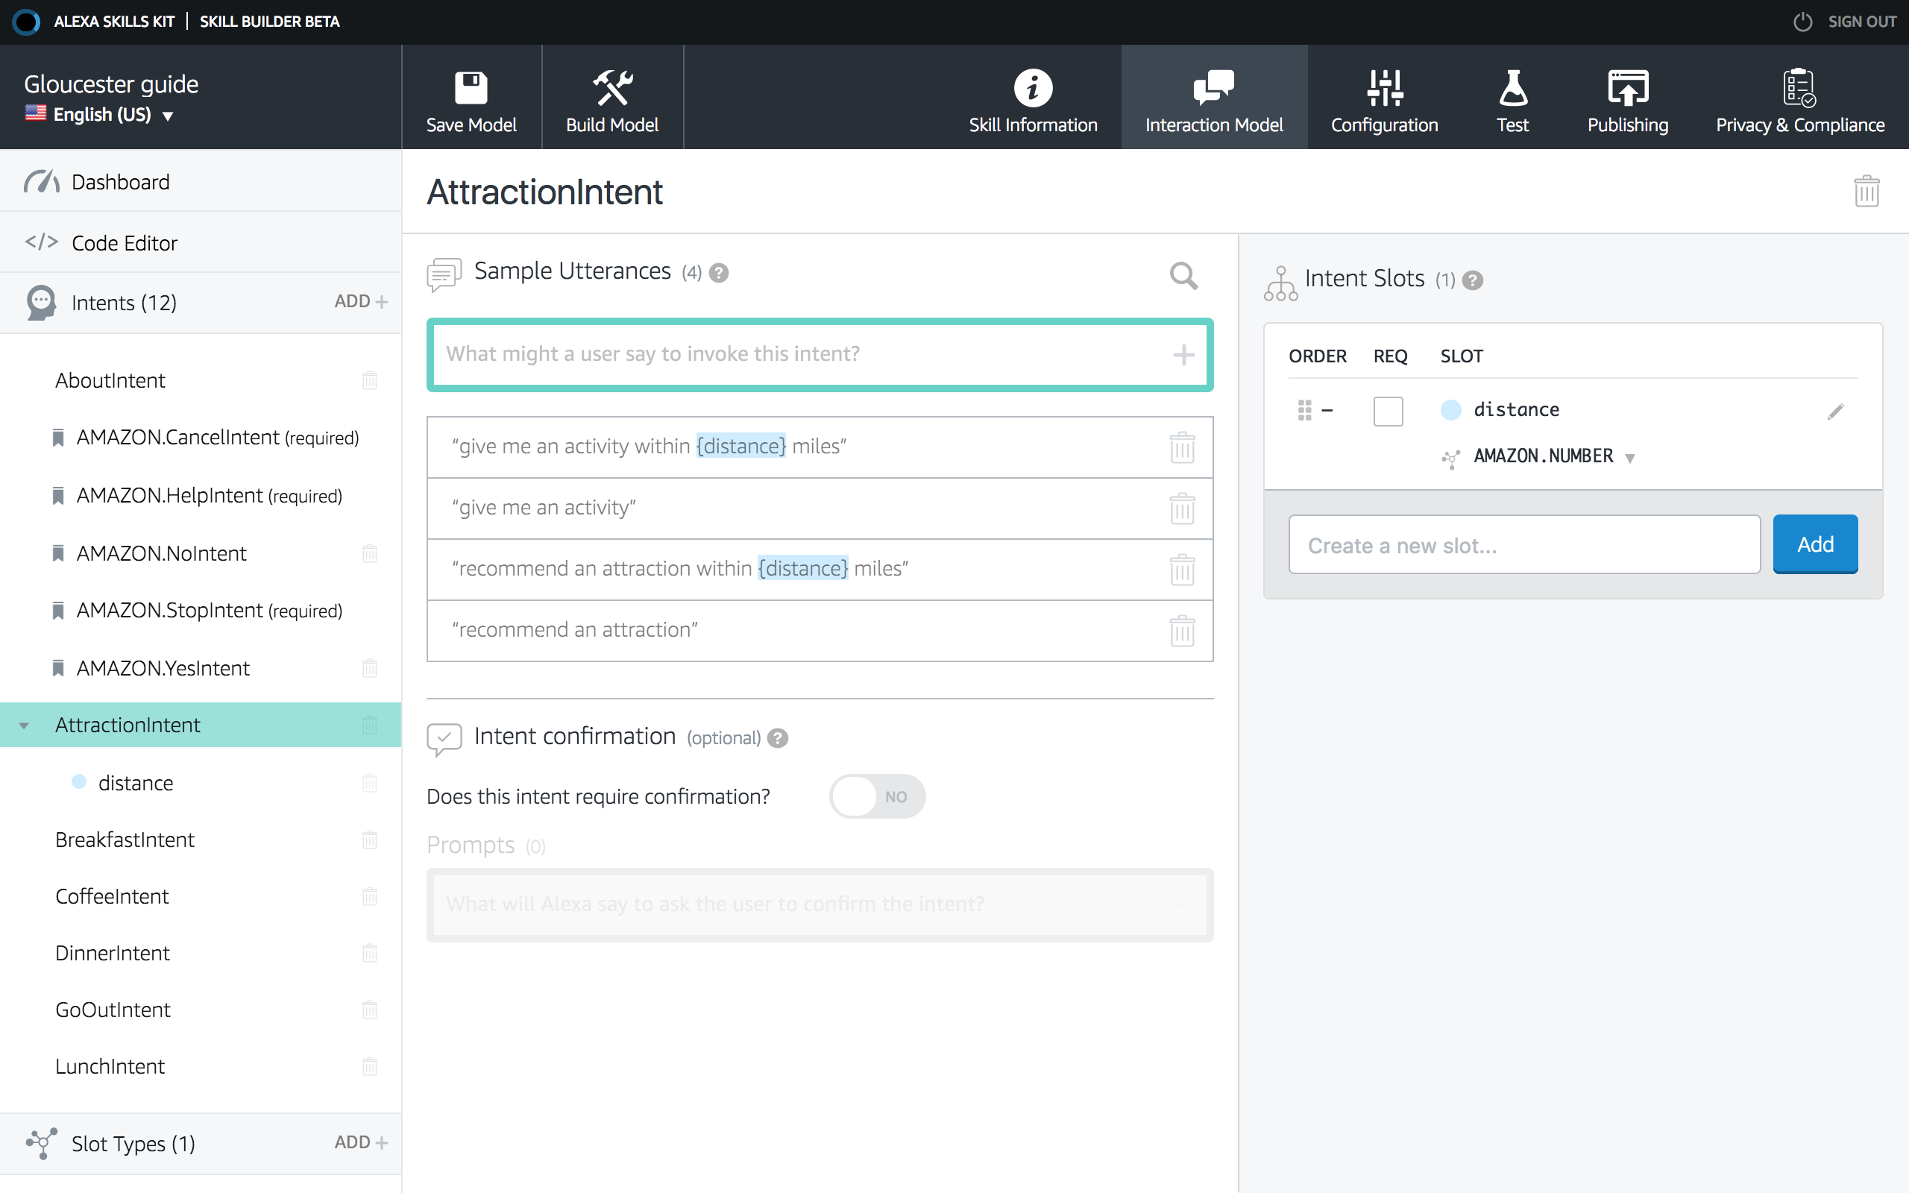

Slide 18
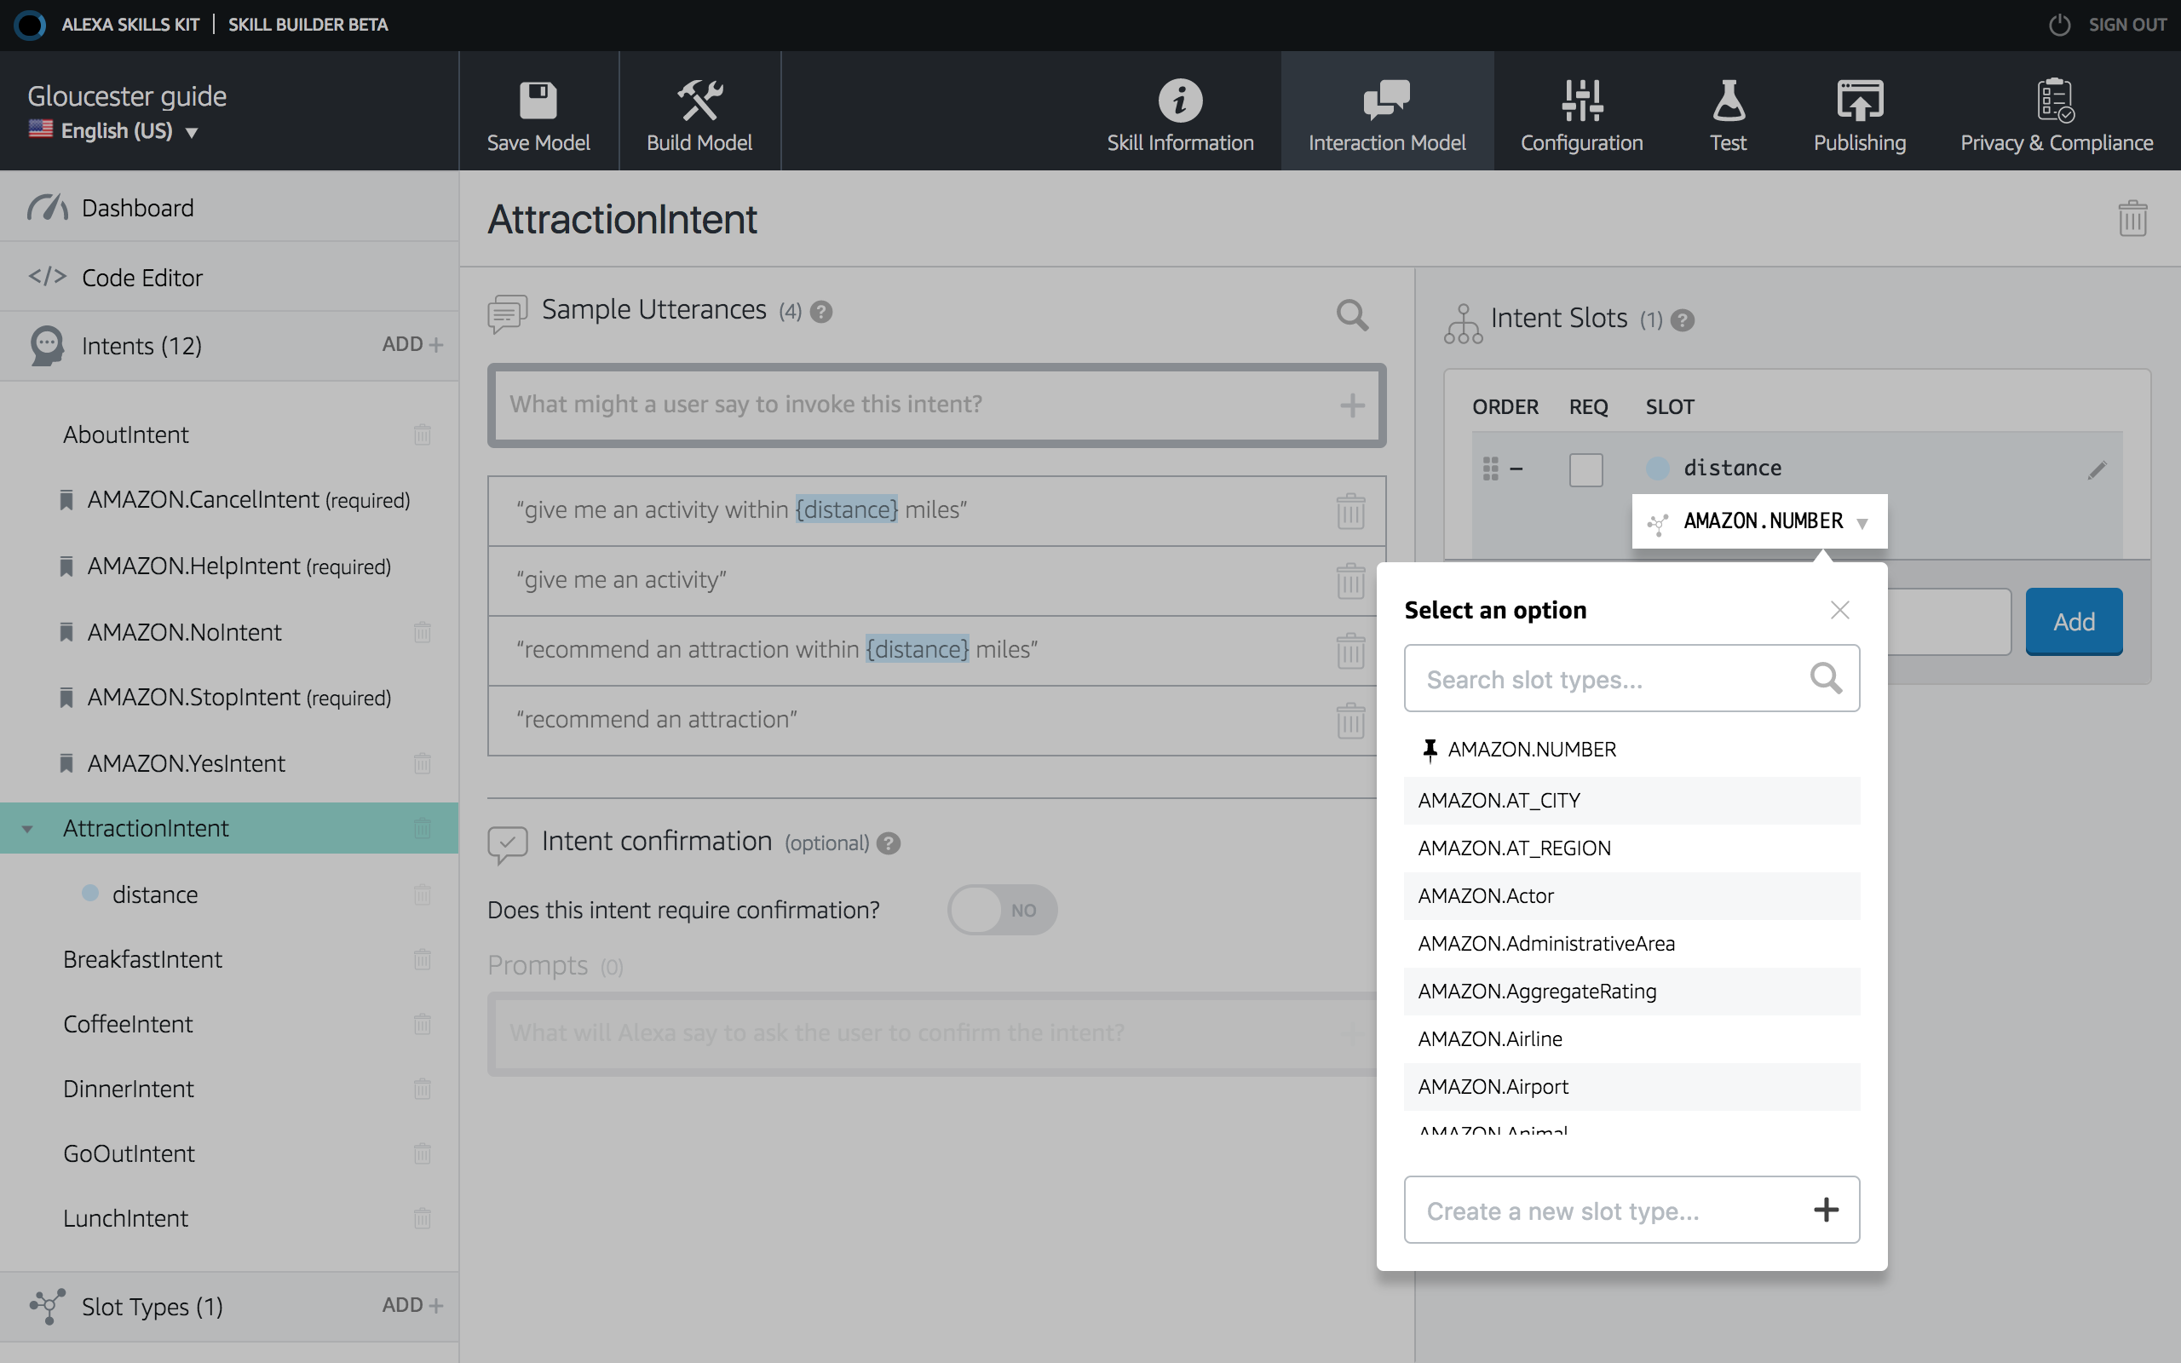

Slide 19
Custom Slots
Tell me about golfing within four miles
slot value
slot value
AttractionIntent
{distance: “4”}
Intent
slot value
AttractionIntent
{activity: “golfing”}
Intent
slot value

Slide 20
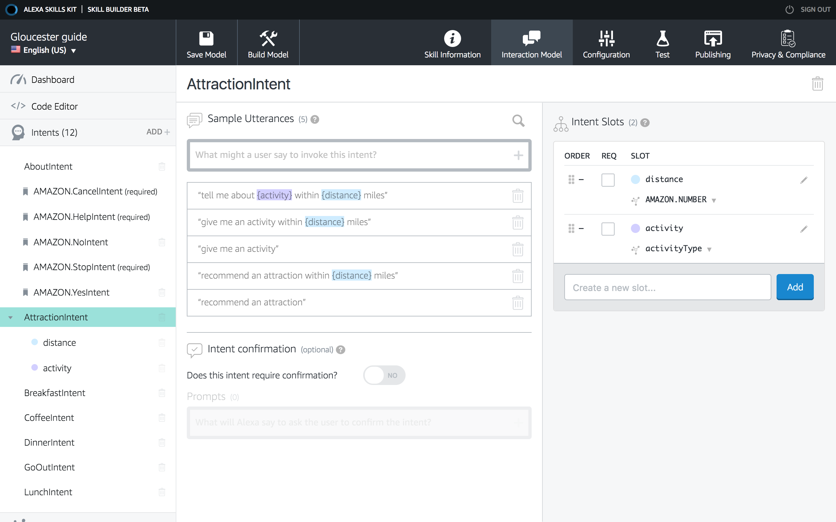

Slide 21
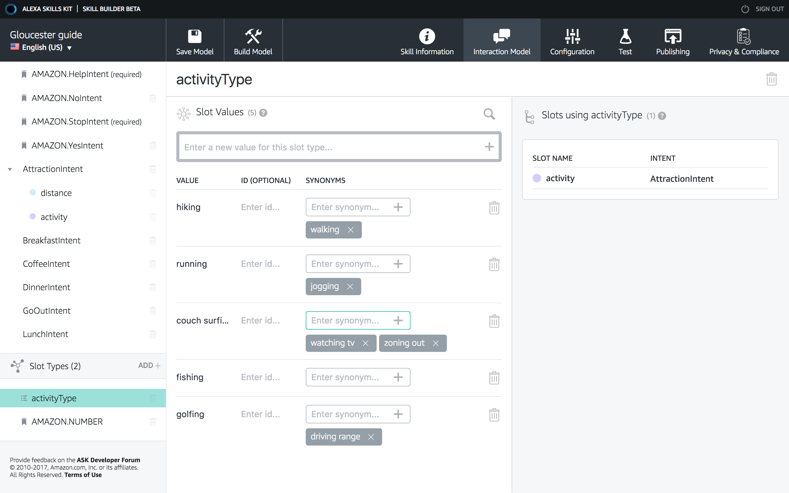

Slide 22
How Do I Receive My Slot?
myDistance = this.event.request.intent.slots.distance.value
myActivity = this.event.request.intent.slots.activity.value

Slide 23
Alexa Skills Kit: Requests and Responses
Your Service
Request
Audio
Speech Recognition
Machine Learning
Natural Language Understanding
Text to speech
Response
Cards

Slide 24
Alexa Skills Kit: Output
Your Service
Request
Audio
Speech Recognition
Machine Learning
Natural Language Understanding
Text to speech
SSML, streaming audio
Text to speech
SSML, streaming audio
Response
Cards

